Slide 2

Baseline Models
We built baseline models – without feature engineering & exhaustive hyperparameter search and found following results – which we tried to further improve upon.
Model | Test AUC Score
Linear Regression | 0.7032
Random Forest Regressor | 0.7318
XGBoost Regressor | 0.7348

Slide 3
Hyperparameter Space & Grid Search
We tried to improve models by introducing different regressors , increasing hyperparameter space and grid search during cross validation to find better models.
We also did the cross validation optimization on both RMSE and AUC score to see if any difference in result.

Slide 4
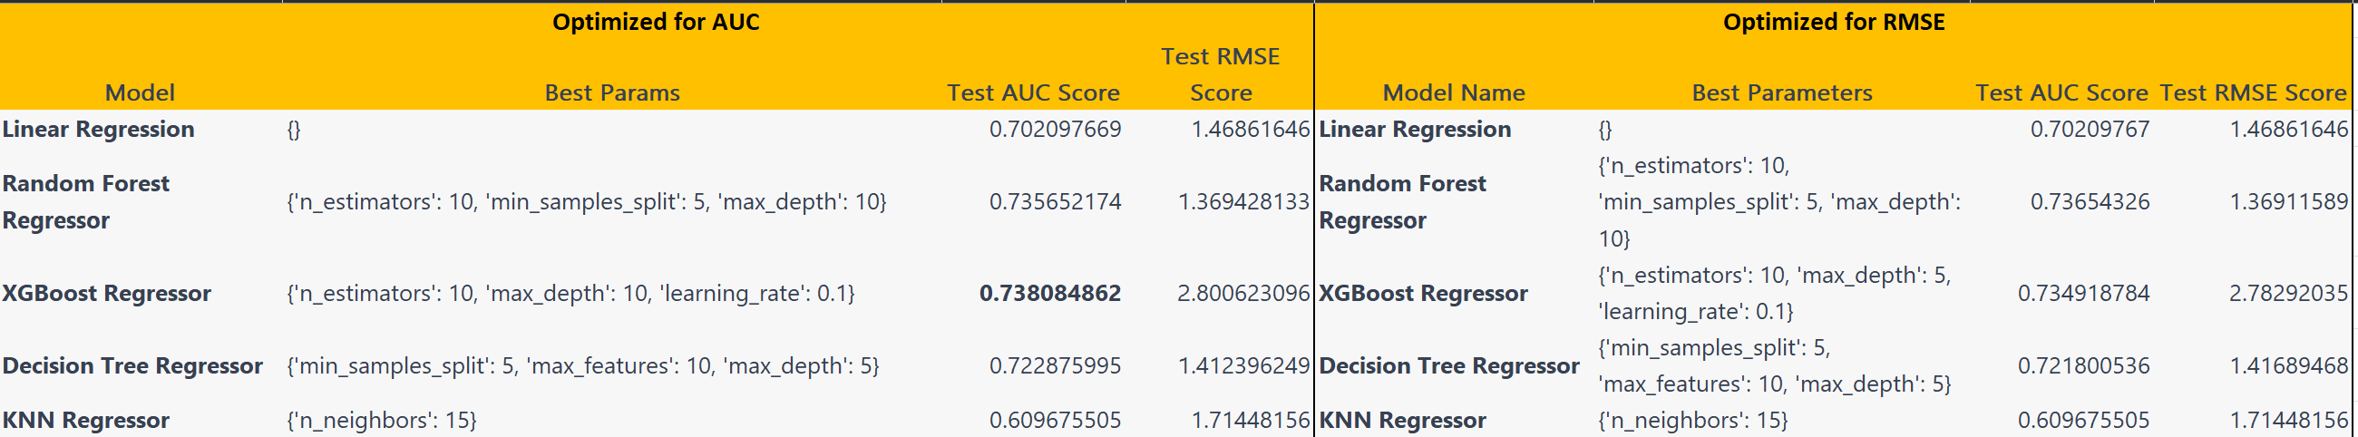
Hyperparameter Space & Grid Search

Slide 5
Feature Engineering
Next we added Feature engineering – two new features added for each existing features.
Added log scaling i.e. log value
Added Gaussian Normalization i.e (value – mean of feature)/standard deviation of the feature

Slide 6
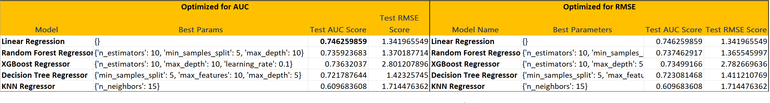
Feature Engineering

Slide 7
Experiments with Neural Network Model
Baseline Neural Network models provided low AUC score and training is not stabilizing i.e. loss is not going down with epochs.
Optimization can not be done on AUC
After adding log scale and normalized features – we see stabilization of loss and AUC score drastically improved , with AUC : 0.7 and RMSE : 1.3

Slide 8
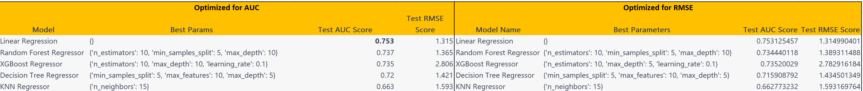
Training with All features
Used all 80 features for training – result improves slightly for linear regression
Note : All tests are done on 20% holdout data

Slide 9
Conclusions
The inherent relationship between DEXA features and MFI is linear – as feature engineering – adding polynomial features and feature selection helps both Linear Regression Model and Neural Network output.
In general for Linear Regression and Neural network model – improving AUC score also showed improving RMSE. Finding a costly surrogate loss to mimic AUC may not be fruitful.
Tree based models like XGBoost and RandomForest provides a good baseline solution , but the limited feature engineering we added – did not help these models.
Increasing the feature space only upticks the Linear Regression slightly – feature selection can be finetuned more.

Slide 10
Conclusions
Best Model is Linear regression , with all 80 DEXA features (where absent cells are less than 20 percent) , with imputed data – AUC : 0.75 , RMSE: 1.3
Challenging part of the problem – Sparse data set , Feature selection – more costly procedures like RFE difficult on 160 features and Using AUC for a regression task – by using custom scoring.
Future work should include – better data exploration , relation between DEXA features and leveraging clustering between DEXA features, Feature engineering based on Age and Sex rather than using them directly – Age/Sex based aggregate feature

